Slide 1
Key Terminologies of Blockchain Technology

Slide 2
Node/Validator/Client
A node is basically a small server that stores, updates and broadcasts a full copy of the blockchain.
A blockchain exists on nodes; If no nodes are online, a blockchain is offline and can’t be updated or used.
In case of Proof-of-Work, miners are always required to run a full-node in order to mine.

Slide 3
Miner aka. Forger
A miner is a node on the network attempting to add new blocks to the blockchain
Participants use hardware to run algorithms on specific software to verify transactions on the blockchain and then add those transactions to the public ledger.
In exchange they receive the reward of a newly-created coin

Slide 4
Distributed Ledger
A type of database which spreads across multiple sites, countries, or institutions.
Records are stored sequentially in a continuous ledger.
Distributed ledger data can be either “permissioned” or “un-permissioned” to control who can view it.

Slide 5
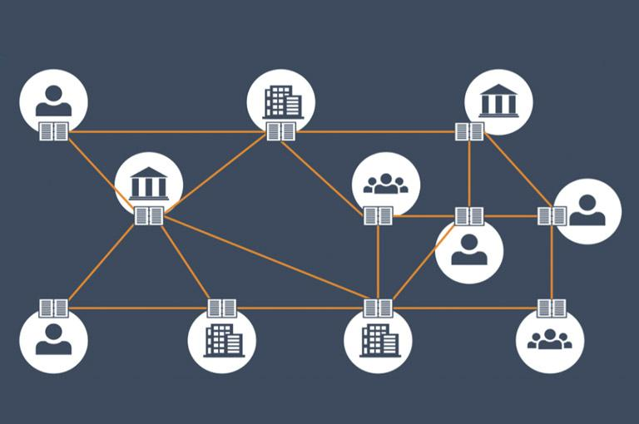
Distributed Ledger

Slide 6
Hashing
A hash is a function that converts an input of letters and numbers into an encrypted output of a fixed length
A procedure that a miner on a Proof-of-Work blockchain constantly repeats in order to find an eligible proof of work
It is the procedure of repeatedly inserting a random string of digits into a hashing formulae until Ending a desirable output

Slide 7
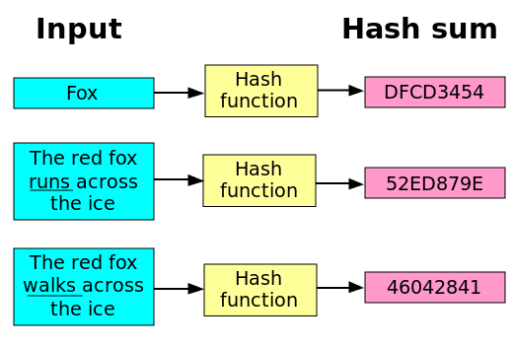
Hashing

Slide 8
Consensus Algorithm
The consensus algorithm is the blockchain element that determines how consensus is reached on that blockchain.
The protocol that describes who gets to validate blocks of data (and thus is entitled to the reward) and how others can verify its legitimacy.
All participating entities on the blockchain must follow the same consensus algorithm to participate on the blockchain.
Responsible for verifying the balances and signatures, confirming transactions, and for actually executing the validation of blocks

Slide 9
Consensus Algorithm: Proof of Work (PoW)
PoW was the first consensus algorithm to be created. It is employed by Bitcoin and many other cryptocurrencies
Miners compete against each other in solving complex computational puzzles. These puzzles are difficult to solve, but when solved, the solutions can be quickly verified.
Once a miner finds the solution to a new block, they can broadcast that block to the network. All other miners will then verify that the solution is correct and the block will likely be confirmed.

Slide 10
Consensus Algorithm: Proof of Stake (PoS)
Instead of investing in expensive hardware to solve a complex puzzle, validators invest in the coins of the system by locking up some of their coins as stake
Validators will validate blocks by placing a bet on it if they discover a block which they think can be added to the chain
Based on the actual blocks added in the Blockchain, all the validators get a reward proportionate to their bets and their stake increase accordingly
A validator is chosen to generate a new block based on their economic stake in the network

Slide 11
Consensus Algorithm: Proof of Authority (PoA)
Instead of solving complex puzzles or staking cryptocurrency (wealth), in PoA you stake your identity
This means voluntarily disclosing who you are in exchange for the right to validate blocks
Any malicious actions you undertake as a validator will reflect back on your identity
PoA blockchains require a thorough form of KYC (Know Your Customer)

Slide 12
Nonce
The nonce is a central part of the proof of work (PoW) mining algorithm for blockchains and cryptocurrencies like Bitcoin.
The nonce is a random, one-time, whole number; which miners test and discard millions of them every second
Miners compete with each other to find a nonce that produces a hash with a value lower than or equal to that set by the network difficulty.
If a miner finds such a nonce, called a golden nonce, then they win the right to add that block to the blockchain and receive the block reward.

Slide 13
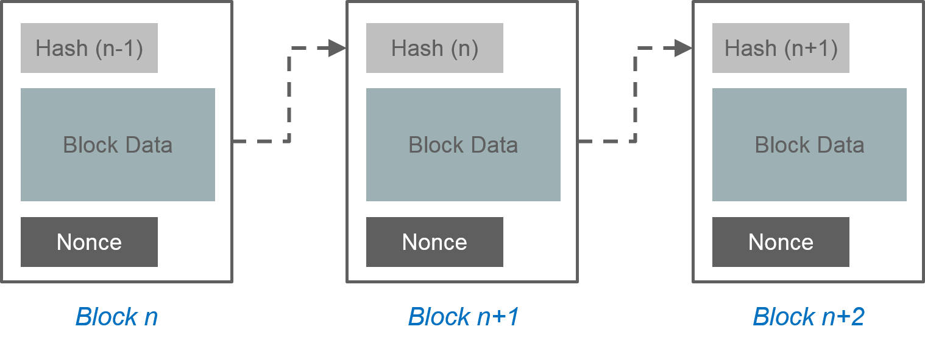
Nonce

Slide 14
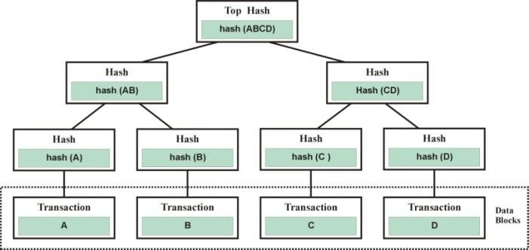
Merkle Tree
A merkle tree is the basic concept of creating blockchain hashing.
It is called a tree because signatures are created from data and then combined with other signatures to create new, comprehensive signature

Slide 15
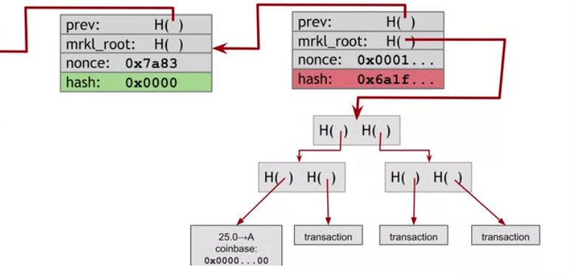
Merkle Tree

Slide 16
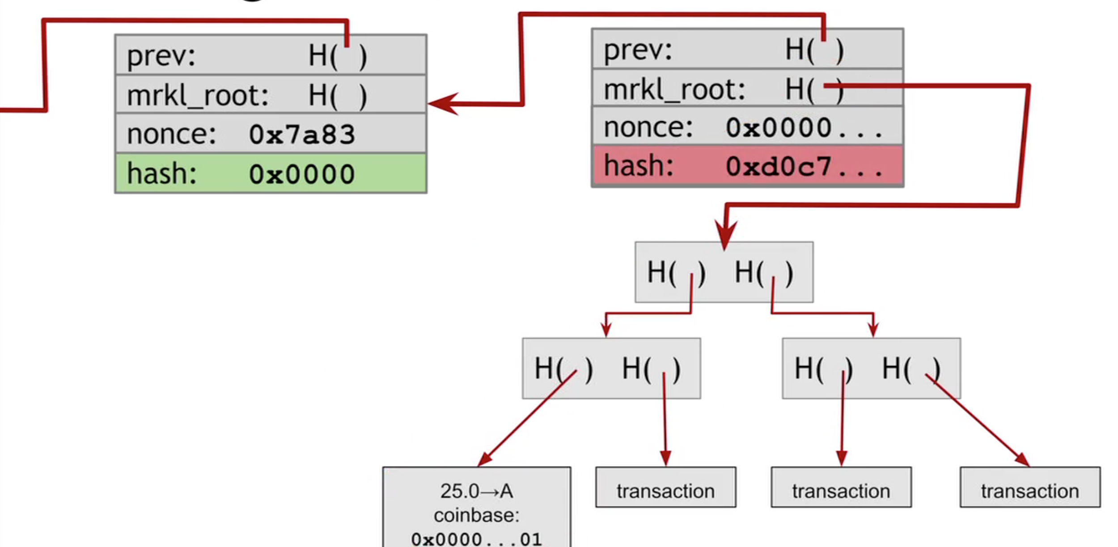
Merkle Tree

Slide 17
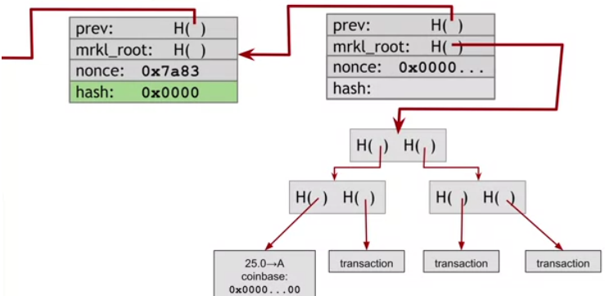
Merkle Tree

Slide 18
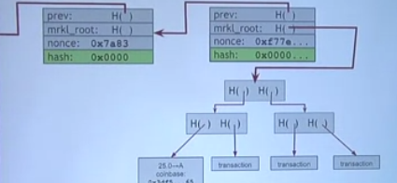
Merkle Tree

Slide 19
Hyperledger
Hyperledger is a multi-project open source collaborative effort hosted by The Linux Foundation, created to advance cross-industry blockchain technologies
It provides the necessary framework, standards, guidelines and tools, to build open source blockchains and related applications for use across various industries

Slide 20
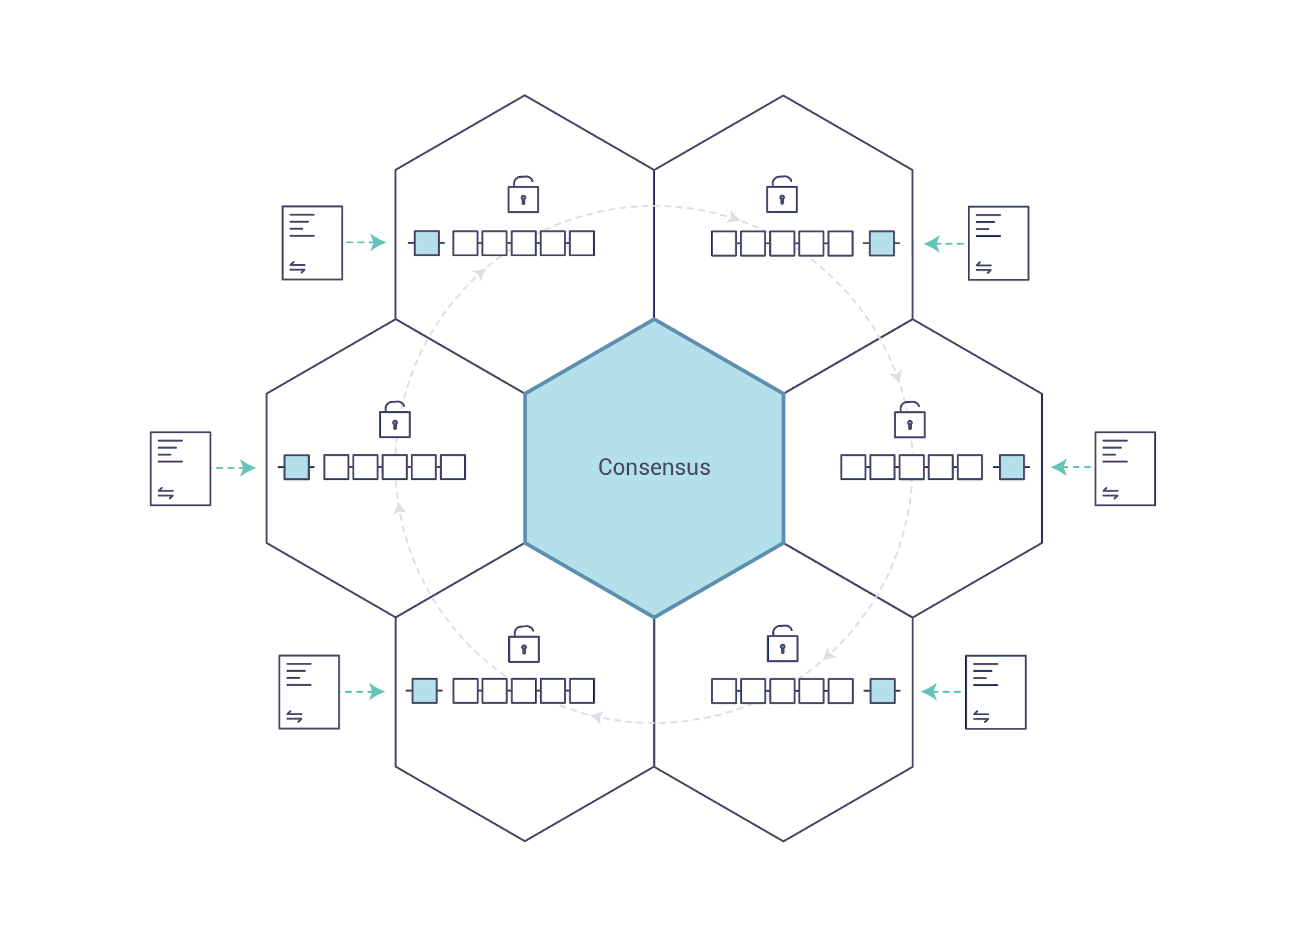
Hyperledger

Slide 21
Permissionless Blockchain
A permissionless blockchain is a blockchain where users don’t need permission from anyone on the network in order to perform certain actions, including joining the network.
Permissionless blockchain is publicly available to anyone, usually very transparent and decentralized
The (voting) power is equally distributed between all network participants. Example: Bitcoin (BTC), Litecoin (LTC)

Slide 22
Permissioned Blockchain
Specific nodes or entities on these blockchains have authorizing powers over others, allowing them to appoint validators and allow or deny access to the network.
Permissioned blockchains have centralized authorities, can be closed and private ecosystems, and are often less transparent

Slide 23
Lightning Network
The lightning network is an extra layer on top of a blockchain that enables faster transaction processing by using ‘payment channels’
A payment channel can be opened between peers (parties) that registers all transactions between these parties without sending them all straight to the actual blockchain.
When the payment channel is closed, all transactions are settled with each other and the Enal outcome of all transactions is sent to the actual blockchain

Slide 24
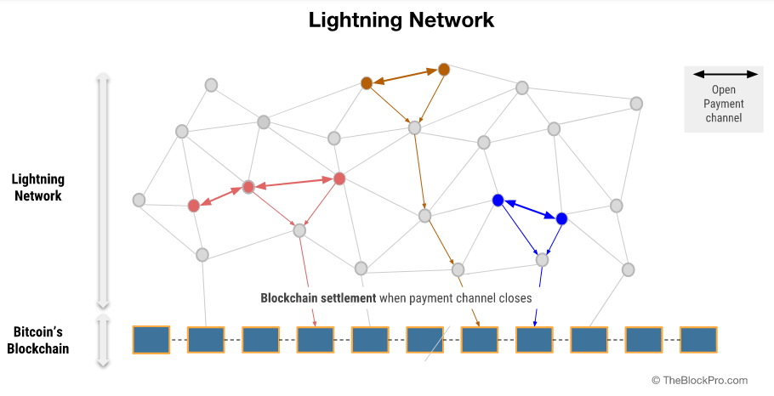
Lightning Network

Slide 25
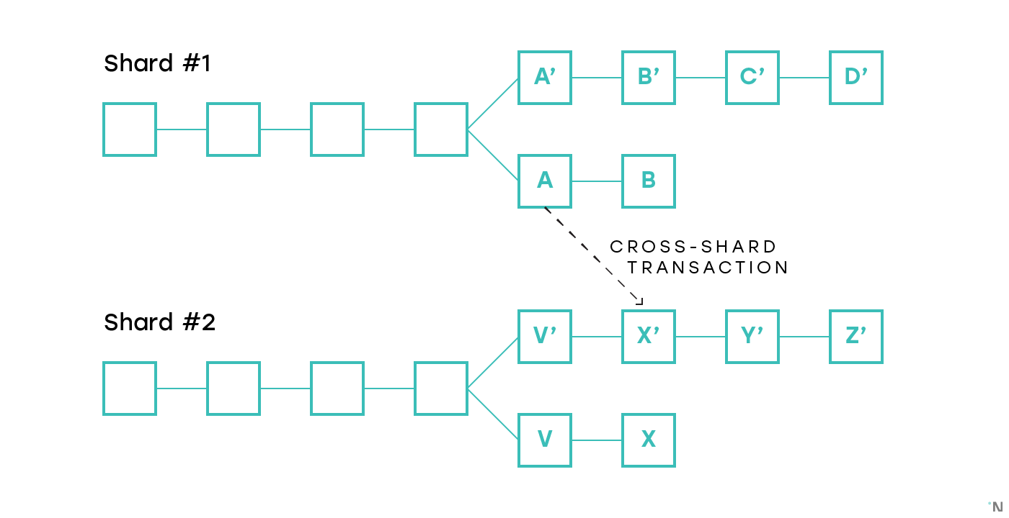
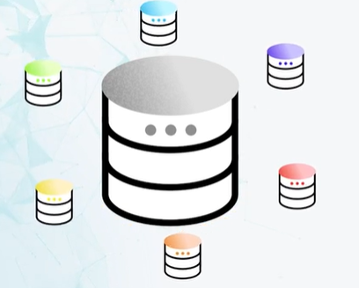
Sharding
Sharding is a form of partitioning a blockchain. Instead of processing all the transactions on one blockchain, other blockchains are run on top of this blockchain

Slide 26
Hard Fork
When an upgrade of the network forces miners and nodes to choose between the upgraded network or the original version of the network.
Both networks function separately and will no longer interact with each other. A miner can only put its resources to work on one of the chains, not both.
A hard fork practically means that the history of the blockchain up until that point has been copied and adjusted by the upgraded network, resulting in two different chains and two different cryptocurrencies.

Slide 27
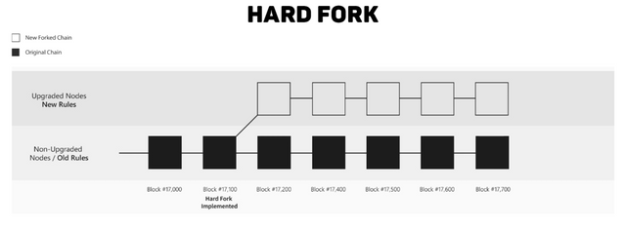
Hard Fork

Slide 28
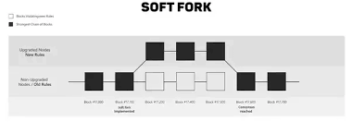
Soft Fork
A soft fork implies an upgrade to the network protocol, just like a hard fork, but it does not force miners and nodes to choose between the old or the new network.
Old nodes and miners can still participate on the new network without upgrading.

Slide 29
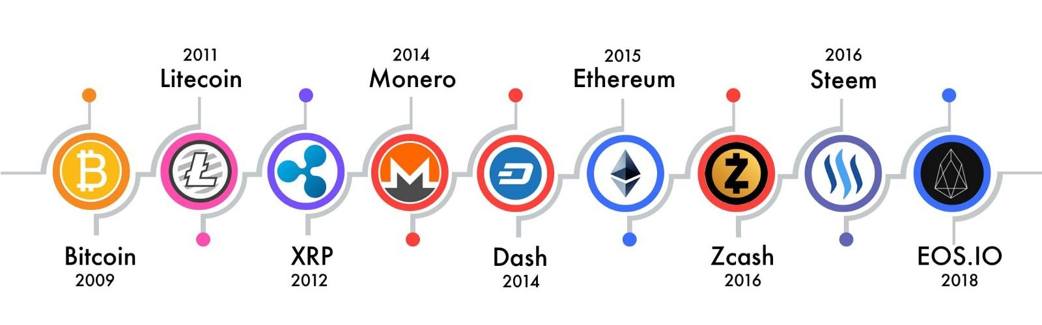
Cryptocurrency
A cryptocurrency (or crypto currency) is a digital asset designed to work as a medium of exchange.
Individual coin ownership records are stored in a ledger existing in a form of secure computerized database
Bitcoin, first released as open-source software in 2009, is the first decentralized cryptocurrency.
Since the release of bitcoin, over 6,000 altcoins (alternative variants of bitcoin, or other cryptocurrencies) have been created.

Slide 30
Fungible vs. Non-Fungible
Fungibility is the ability of a good or asset to be interchanged with other individual goods or assets of the identical type, e.g. Dollar, Bitcoin
One Dollar is and will always be one Dollar, just like any other Dollar.
Some other tokens can be non-fungible, meaning that these tokens can have unique mutual differences, e.g. CryptoKitties
CryptoKitties is a blockchain game on Ethereum that allows players to purchase, collect, breed and sell virtual cats
Currently almost 3 million dollar worth of non-fungible items are in the market

Slide 31
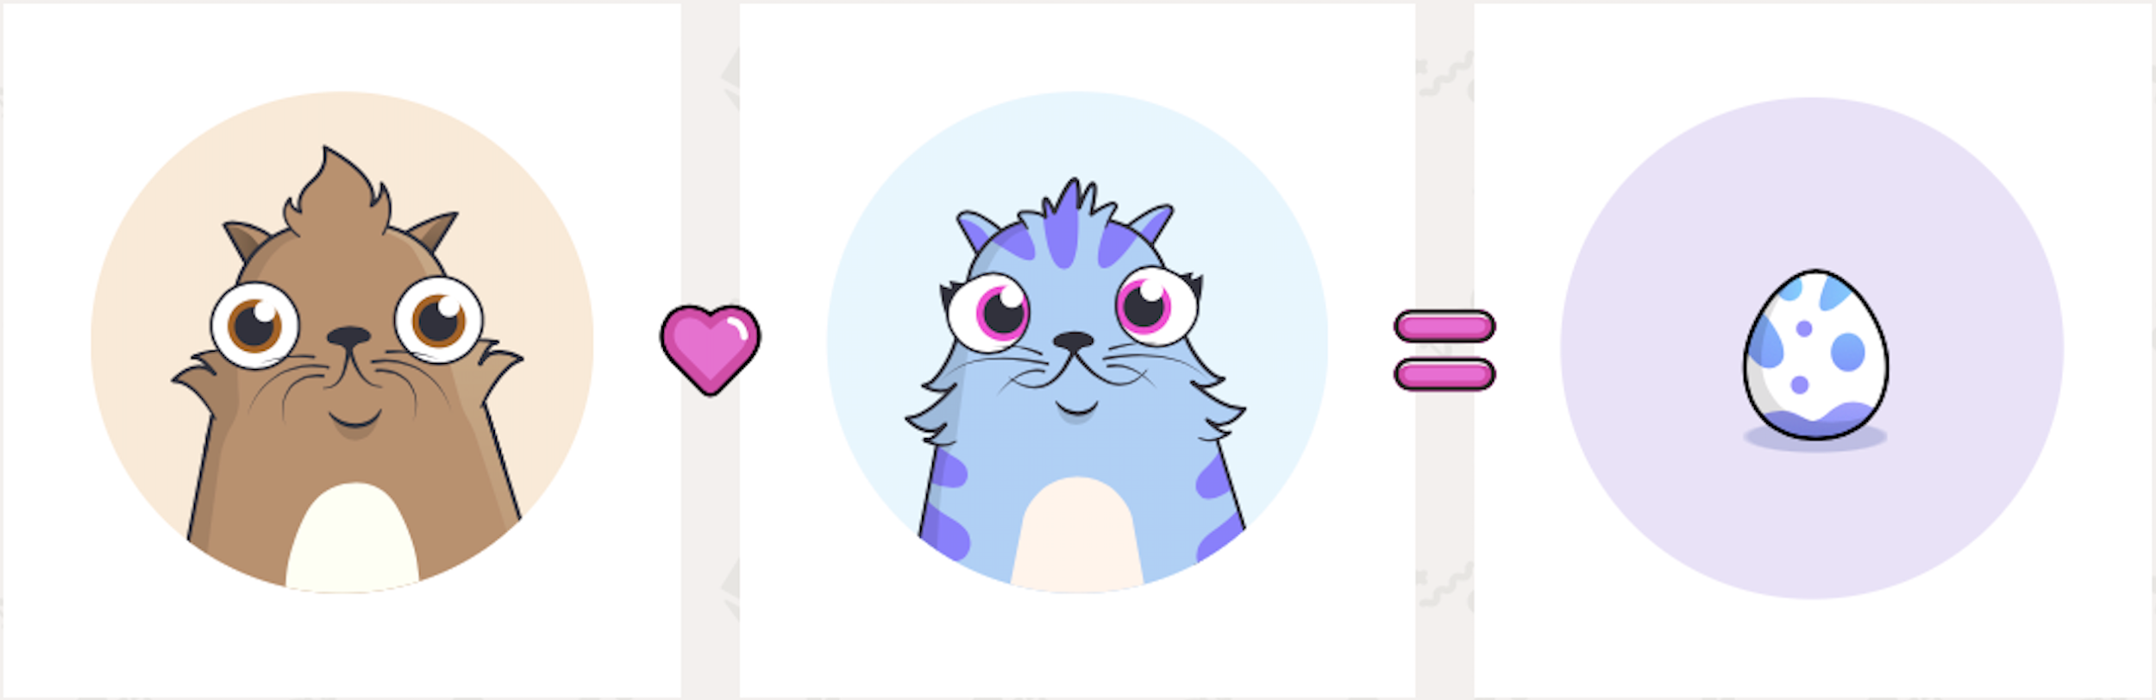
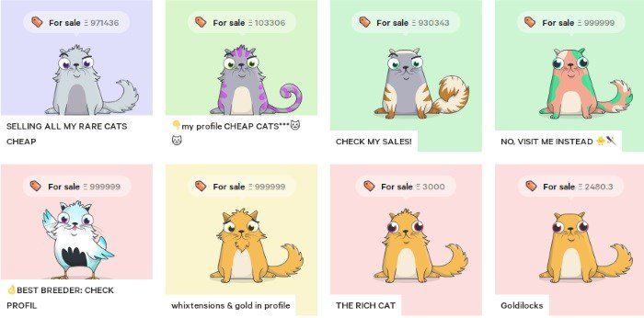

Slide 32
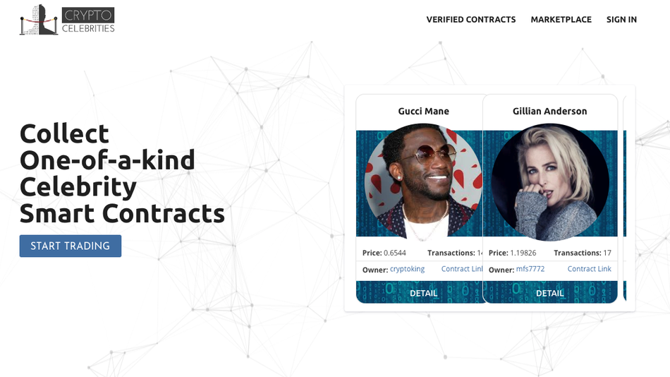
CryptoCelebrities

Slide 33

Digital Art

Slide 34
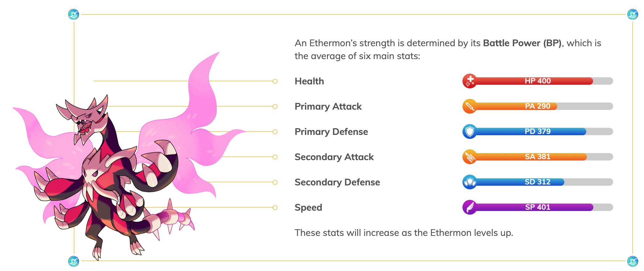
Ethermon

Slide 35
dApps
dApp stands for decentralized application.
dApp could be any smart contract deployed on the blockchain, as they all operate autonomous, aka decentralised.
CryptoKitties, CryptoCelebrities, Ethermon, etc. are all examples of dApp

Slide 36
Smart Contract
A smart contract is a digital contract programmed on a blockchain
A smart contract is deployed on an address on this blockchain and cannot be moved nor changed afterwards.
The contract (basically a script) operates and executes fully automatic without any interference from a third party. It is publicly available to anyone to read and use.

Slide 37
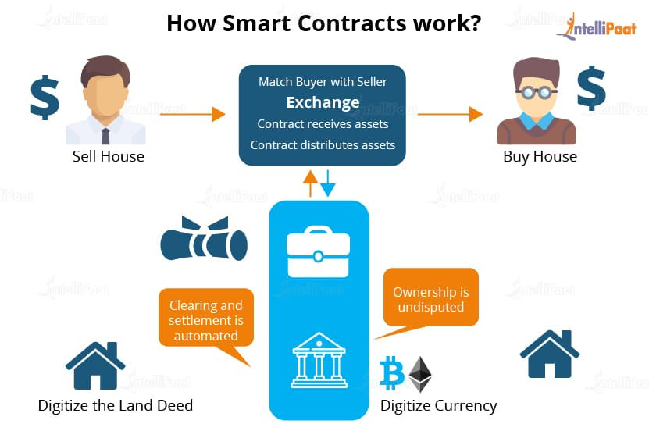

Slide 38
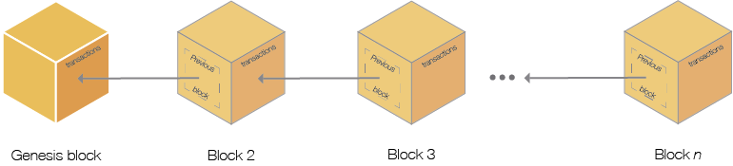
Genesis Block
The genesis block is often referred to as the first block on a blockchain.
The genesis block of Bitcoin was created on January 3, 2009; and indicates the birth of the Bitcoin blockchain

Slide 39
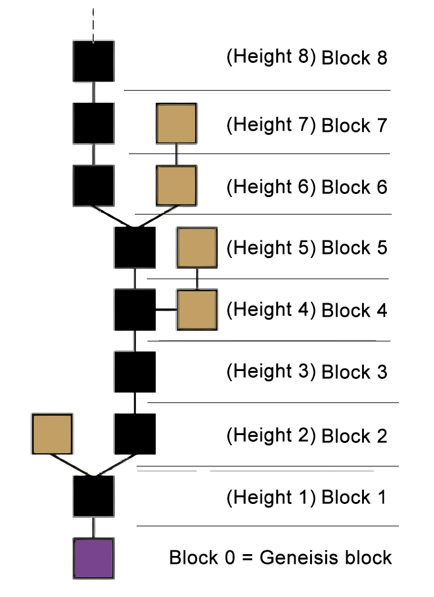
Block Height
The number of blocks connected together in the blockchain.
For example, Height 0 would be the very first block, which is also called the Genesis Block.

Slide 40
Confirmation
The amount of confirmations a block has refers to how many blocks have been added on top of that block on the blockchain.
Every added block counts as a confirmation because all nodes on the network indirectly also verify (confirm) the blocks before it again.
The more confirmations a block has, the less likely it is to be altered (harder to attack), thus the safer the transaction is considered to be

Slide 41
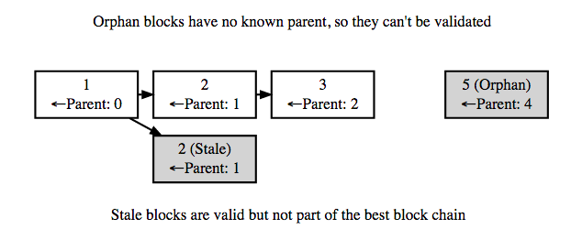
Stale/Uncle and Orphan Blocks
A stale block is a valid block that was once broadcasted by a miner while another valid block was being broadcasted by another miner simultaneously.
Nodes will only register one of these blocks, depending what block reaches them first.

Slide 42
Block Reward
The reward given to a miner after it has successfully hashed a transaction block.
Block rewards can be a mixture of coins and transaction fees.
The current block reward for the Bitcoin network is 6.25 bitcoins per block.

Slide 43
Bounty / Bug Bounty
A reward that’s paid for the completion of a given task.
Tasks include:
Identifying code vulnerabilities
Creating content
Design work
Research
Translations
Brute force and more

Slide 44
Wallets
A blockchain wallet is a digital wallet that allows users to manage digital currency
Each Wallet has a unique ‘Wallet ID’, which is equivalent to a bank account number. Every cryptocurrency transaction refers to ‘Wallet ID’ of buyer and seller
A wallet is referred to be “Hot” if it is online and “Cold” if it is offline

Slide 45
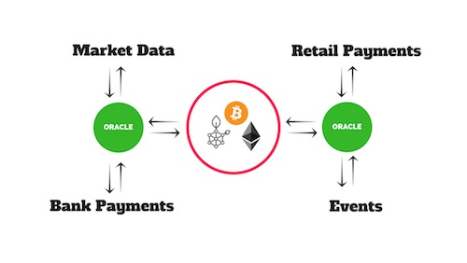
Oracle
An oracle, in blockchain, is a software application that verifies real-world occurrences (such as a shipment of cellphones) and submits this information to blockchains.
Oracles are basically data transformers and transmitters, converting real-world occurrences into data for blockchains

Slide 46

Satoshi Nakamoto
A mysterious individual or entity who created the Bitcoin protocol, solving the digital currency issue of the “double spend.”
Nakamoto first published their white paper describing the project in 2008 and the first Bitcoin software was released one year later.

Slide 47
Thanks!
Do you have any questions?

